Slide 1

Policy and Climate:
The State of Global Play
Thomas C. Heller
Stanford Investment
June 3, 2015
BRAZIL
CHINA
EUROPE
INDIA
INDONESIA
UNITED STATES
235 Montgomery St. 13th Floor
San Francisco, CA
94104, USA
climatepolicyinitiative.org

Slide 2
About Climate Policy Initiative
Finance and Investors
Optimizing policy regimes for low cost financing
Cataloguing investment risks, barriers and solutions
Identifying new investment opportunities and potential catalysts
Assessing investor response:
- Institutional Investors
- Banks
- Corporate investors
- Government Agencies
Policymakers and regulators
Identifying effective policy solutions including:
- Market structure
- Incentives
- Regulation
- Financing
Articulating barriers to implementation
Testing policy from real world examples and institutions
Climate Policy Initiative
Climate Policy Initiative (CPI) works with the public and private sector to decrease the cost – and increase the value – of low-carbon alternatives.
Our team of advisors and analysts has deep expertise in finance, strategy and policy for clean energy and infrastructure, and works with governments, utilities, companies, banks, investors, and foundations around the world to lower the cost of the transition to a low-carbon energy system.
Corporations (including utilities)
Crafting business models and regulatory regimes to enable access to new market opportunities
Evaluating response to incentives and regulation
Assessing financing costs
Project structuring
Regulatory Strategy

Slide 3
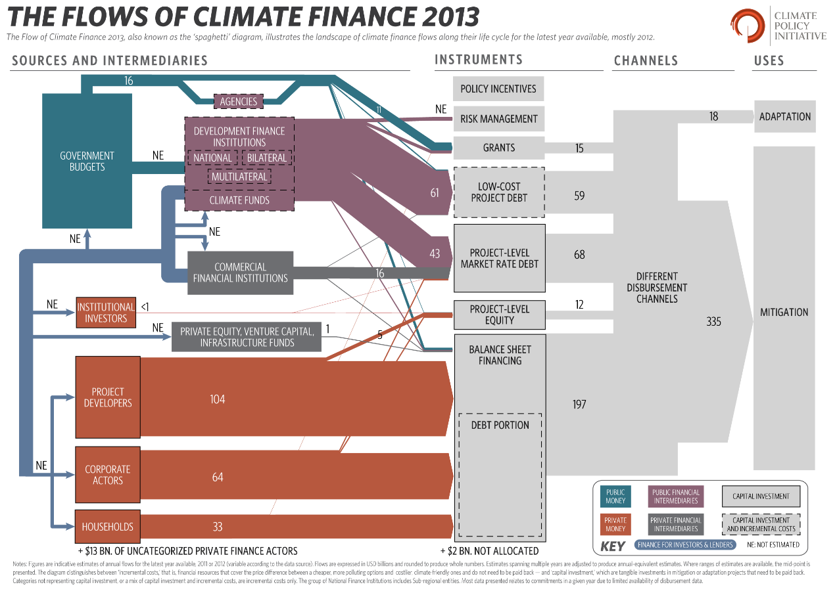
© CPI 2012

Slide 4

  Government budgets face the biggest potential change due to mitigation policies – Oil and Gas is a good example
Commercial Oil Company Free Cash Flows
National Oil Company Free Cash Flows
Government Take
(Taxes, Royalties)
Capital Expenditures
Operating Costs
Source : Rystad, CPI
Governments and Government owned companies will receive close to 90% of the net present value of future oil production between now and 2050

Slide 5
  Governments control the largest share of potentially stranded assets – Coal fired power plants is another example
Public Market Investors Own, Control and Suffer Climate Risk for only 11% of Coal Power Plants globally
Government Owned
ListCo – Government Share
ListCo – Investor Share
Publicly traded – IOU/IPP
Private/Ind. Cogen/Other
Ownership, control and risk are not always aligned
Government Controlled
(61%)
Investor Controlled (27%)
Other
(12%)
Taxpayer at risk (55%)
Investor at risk (17%)
Ratepayer at risk (16%)
Other
(12%)
Unregulated
Regulated

Slide 6
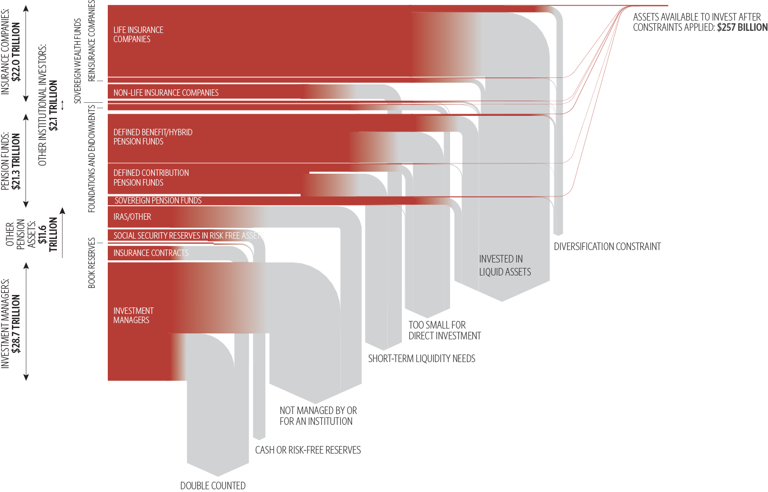
Institutional Investors are well positioned for renewable energy projects but illiquidity, project size constraints, and diversification requirements limit direct investment
Potential direct institutional investment in renewable energy projects

Slide 7
Integrating the pieces into a new model presents the sixth challenge
Current Model
Possible Future Model
Independent Power Producers
“Yieldcos” – Wind, Solar, Nuclear, Some hydro and other long term non-dispatchable
Municipal financed generation & Industrial financed generation
Balancing Gencos (with national reach)– Dispatchable Gas, Coal, Some Hydro
Investor Owned Utilities
Operating contractors and service providers?
1 to 3 National or multistate Transmission operators (owners)
Generation
1 to 3 National or multistate Independent System Operators
Transmission
Market balancing
Regional Distribution companies
Distribution companies
Municipal Distribution Companies
Distribution
Distribution companies
Customer service and billing
Competitive Energy resellers (and Traders)
Competitive Energy resellers
Energy Service Companies
Competitive Energy resellers
Competitive Energy resellers

Slide 8
Employing these models in ways that link into developers’ initial investment decisions could significantly reduce renewable energy costs
With today’s model a typical wind project today could cost around $80/MWh
The financial crisis has caused banks to reduce the term of debt offered – This could add 15-24% to energy costs
Some developers enhance returns by selling projects to other investors – only 3% would go back to lower prices
As risk falls and competition increases, some utilities are financing on balance sheet – This could reduce cost by 6%
New business and financing models that are linked to developer investment decisions could reduce costs by 20%
Levelized Cost of Energy ($/MWh)
US *
Change in Cost from Current Industry Model
Europe/International
* This model assumes the developer can monetize excess accelerated depreciation benefits immediately; an in ability to do so increases the cost of renewable energy and the benefit of new business models

Slide 9
Renewable Energy and Clean Infrastructure could provide an excellent match for an institution’s investment needs, if structured appropriately
Direct Investment in Renewable Energy projects
offers liability hedging at higher returns:
“Return Seeking”
Typical Renewable Energy characteristics versus liability hedging needs
Venture Capital
Levered
Private
Equity
Risk
With appropriate contracts and regulation can be very low with Beta approaching zero
HIGHER RETURNS
Public Equities
Cash Flows
High initial investment followed by steady cash flows mimics fixed income, but with potentially lower default risk (depending on regulation and contract/tariff counterparty)
Direct Investment
Renewable Energy
Projects
LOWER RISK
Speculative
Grade
Bonds
Returns
Similar to corporate bonds, but with a slight premium for similar risk categories
“Liability Hedging”
HIGHER RISK
Infrastructure
Duration
Very long durations potentially available
Investment
Grade Corporate
Bonds
Growth and inflation hedge
No growth, but cash flows available to re-invest; can provide energy price hedge
Treasuries
LOWER RETURNS

Slide 10
Several issues with current renewable energy offerings reduce the value of these investments to institutions
Issue with current offerings
Illiquid infrastructure investments
Direct investments in projects can be difficult to sell if unexpected cash needs arise. This illiquidity can discourage investors or limit its share in the portfolio. Illiquidity can also raise costs as investors may need to offset illiquid investments with very liquid, but lower return, assets elsewhere in the portfolio.
Direct investment can be expensive as transactions take time and require highly skilled and expensive resources. The higher return of direct investment may only justify the cost for investors seeking to make multiple high value investments over which team costs can be spread.
High transaction costs
Many projects seem too small to justify transactions costs (requiring aggregation and bundling) or may be too large for a single investor (requiring syndication or an intermediary). A shortage of projects in the “sweet spot” creates competition which pushes down returns.
Insufficient projects suitable for direct investment
Market/regulatory barriers and risks
Regulation can exclude or discourage investors that are not immersed in the industry, may induce risks or may require risk management techniques that favor incumbents. Policy support and analysis is often necessary to achieve optimum value.
Most assets are currently owned or financed by incumbents or intermediaries (banks, utilities) with objectives that are not aligned with institutional or renewable energy needs. Asset managers/ infrastructure funds often ask for high fees that are justified through active management (buying and selling assets) that reduces the liability hedging value of renewable energy ownership.
Asset owner objectives misaligned with institutions

Slide 11
Properly addressing these issues could create value for institutional investors, project sponsors and energy consumers
Issue with current offerings
Pathway to value creation
New investment models optimized for institutions
Illiquid infrastructure investments
Create liquidity through
structuring of investment vehicle
High transaction costs
Share transactions costs among investors and develop new methods
Insufficient projects suitable for direct investment
Create systems to access a larger pool
of projects (both large and small)
Value creation realized through new financial models
Market/regulatory barriers and risks
Diversify across regimes and develop active policy/regulatory management
Asset owner objectives misaligned with institutions
Disintermediate banks/utilities and
tailor investment for Institutions

Slide 12
The key is to begin from the institutional investor perspective and develop new investment models optimized for their needs
Issue with current offerings
Pathway to value creation
New investment models optimized for institutions
Illiquid infrastructure investments
Create liquidity through
structuring of investment vehicle
Develop new listed vehicles or create liquid market
(e.g. YieldCos, Investment Trusts)
High transaction costs
Share transactions costs among investors and develop new methods
An investment club could share costs to benefit members
Insufficient projects suitable for direct investment
Create systems to access a larger pool
of projects (both large and small)
Large projects can be split among investors, while a consortium could aggregate small projects
Market/regulatory barriers and risks
Diversify across regimes and develop active policy/regulatory management
Investors working together could invest in a larger, more diverse set of projects
Asset owner objectives misaligned with institutions
Disintermediate banks/utilities and tailor investment for Institutions
Investors structure investment vehicles with developers to meet their own investment needs

Slide 13
This group will evaluate the importance of various issues, investment characteristics and barriers for the investment case for institutions
LOWER
HIGHER
Investment Consideration Dimensions
Project bonds
Private placement project debt
Preferred project equity
General partner project equity
Corporate equity
Corporate debt
YieldCo
HoldCo – “Pure” YieldCo*
Renewable energy equity fund
Renewable energy debt fund
Investors Club
Private investor owned company (project developer)
RETURN
Investment Vehicles
Return on investment (ROI) upside
F
A
B
J
H
C
G
E
D
I
K
L
Cash flow certainty /Dividend security
L
I
K
D
C
E
G
H
B
J
F
A
B
Preliminary
Duration
I
E
C
D
G
J
F
A
B
K
H
L
Environmental/SRI characteristics
E
F
B
A
C
D
G
J
I
H
K
L
Geographic/Business diversification
G
RISK
D
C
A
B
E
I
F
J
G
H
K
L
H
Liquidity
L
K
B
D
A
C
J
I
F
H
E
G
Inflation hedge value
B
A
C
H
D
F
J
G
I
E
K
L
L
Pricing transparency
L
D
B
K
C
G
H
A
J
I
F
E
Transaction cost/ Management effort
A
F
E
C
Preliminary
B
G
H
J
I
D
K
L
EASE of INVESTMENT
* A “HoldCo” is a YieldCo type investment that offers 100% dividend payout and no growth, therefore eliminating uncertainty around new asset acquisition and development
Investment cost
E
F
H
G
I
J
A
B
C
D
K
L
Minimum investment size
E
F
H
G
A
B
I
J
C
D
K
L

Slide 14
Summary
Direct investment in renewable energy can provide attractive risk/ return for institutional investors; particularly for liability hedging
However, current financing options reduce the value and decrease the attractiveness of these investments to institutional investors
CPI is looking to coordinate a small set of large institutions seeking to design new types of financing options that will overcome these barriers
A roundtable to be held in June 2015 will be one important first step in this process

Slide 15
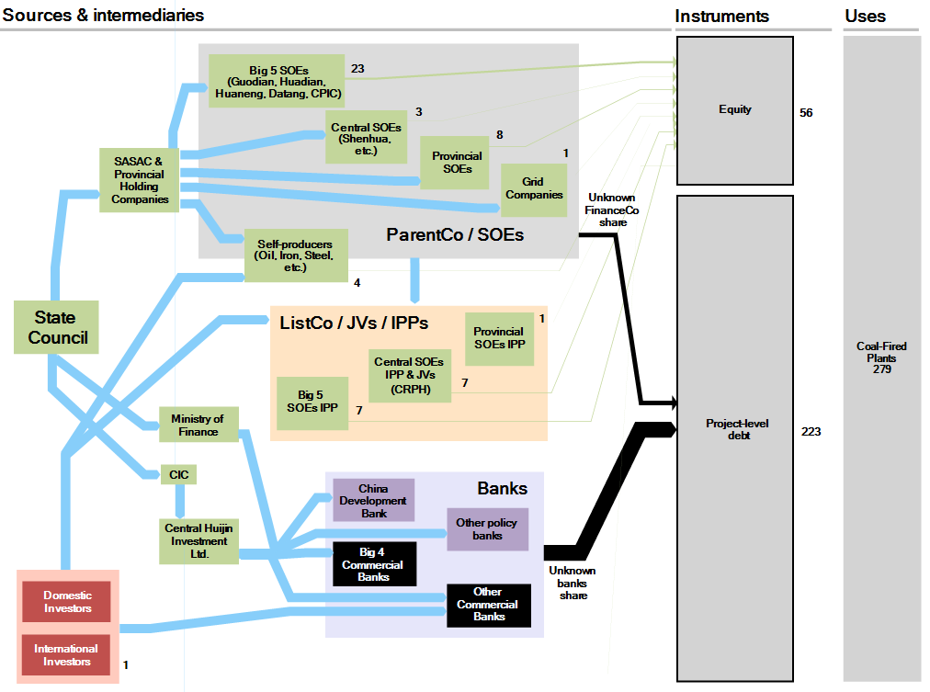
China Domestic Coal-Fired Power Investment
Total 2012 Estimated Investment: c. USD 40-50 bn.

Slide 16
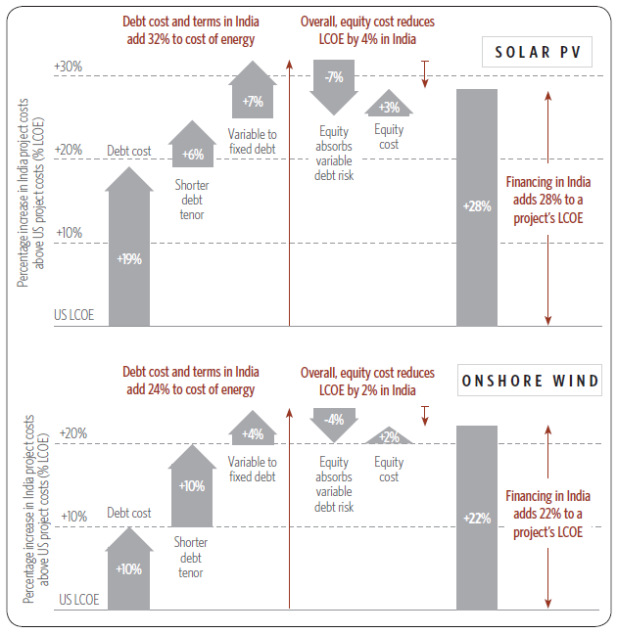
Unfavorable debt terms raise the cost of renewable energy by ~30%
Impact of debt and equity costs and terms in India on overall financing costs compared to a US baseline
India aims to more than double existing renewable energy capacity by 2022.
Renewable energy is expensive compared to conventional power, and requires policy support.
In our previous work, we found that high (and variable) interest rate and short tenor of debt add ~30% to the cost of renewable energy.
Question: What federal policies would be the most cost-effective?
Source: Meeting India’s Renewable Energy Targets: The Financing Challenge (2012), CPI
Notes:
What is the problem?
Renewable energy is more expensive in India despite lower land and labor costs compared to the US and other developed economies
Availability and terms of debt are the main stumbling block
High cost, short tenor and variable interest rates add about 30% to the delivered cost of renewable energy

Slide 17
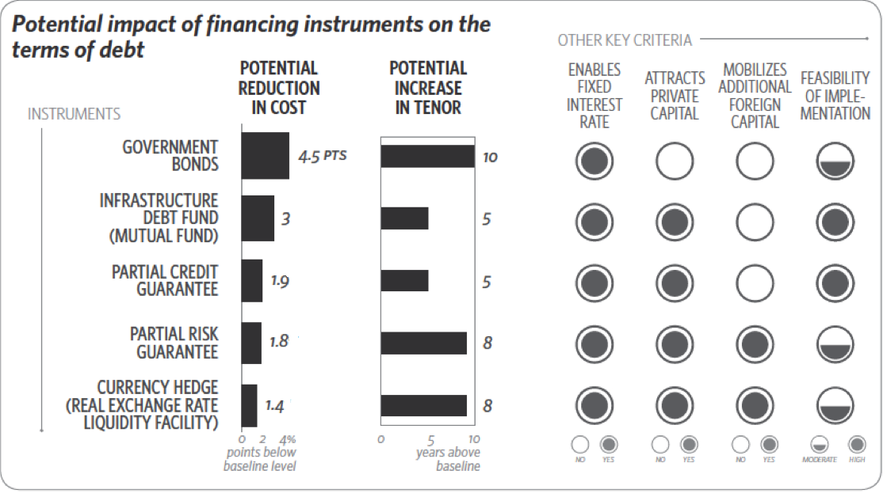
Innovative financing mechanisms can reduce the cost of debt by up to 4.5% points
Notes:
The government cannot be expected to meet the full capital requirement for renewable energy projects. There is a need to channelize private investment towards the sector as well.
Using innovative financing instruments, it is possible to improve the availability and the terms of debt for renewable projects. In this paper, we look at 5 such instruments.
We explore instruments that can facilitate domestic institutional investment (partial credit guarantee and infrastructure debt funds) as well as foreign investment (real exchange liquidity facility)
We find that innovative financing mechanisms can help reduce the cost of debt by up to 4.5 percentage points and extend tenor by up to 10 years.
In the case of government bonds, the cost reduction is due to the government passing on its ability to raise funds at the lowest possible rate of interest (8%) and passing on that benefit by directly on-lending proceeds to project developers. The government can also raise long-term debt from the market.
Infrastructure debt funds (IDFs) can reduce the cost of funds by diversifying the risk associated with a single renewable energy project, and leveraging management and sector expertise for a large number of projects. Institutional investors also have a longer investment cycle of 15-20 years compared to commercial banks.
Partial credit guarantees reduce cost by providing access to capital markets since the return on institutional investment is slightly lower than the interest on commercial loans. Without partial credit guarantees, renewable projects cannot raise money from capital markets since institutional investors require a minimum rating of AA.
Partial risk guarantees mitigate policy and regulatory risks for foreign investors, thereby reducing the cost of foreign loans for renewables. Foreign institutional investors have a longer lending cycle of 20 years.
However, the largest cost component of foreign lending is the cost of hedging. A currency hedge (in the form of a real exchange rate liquidity facility) which would manage currency fluctuations and volatility up to a pre-defined limit by providing a standby line of credit can help address this problem.
Implementation feasibility for IDFs and PCGs is high since the regulatory framework is conducive to such financial mechanisms and they have already been used to mobilize funds for infrastructure in the past. Implementation feasibility is moderate for government bonds, partial risk guarantees and currency hedge since they would require the government’s cooperation and there is no precedent for such instruments successfully being implemented for renewable energy in India.

Slide 18
4x
Productivity (value of production/unit of land)
A growing population and middle class means it’s more important than ever to use land wisely. To meet our needs we must improve agricultural productivity while avoiding expansion into carbon-rich areas.
Central-Western
Brazil
(excl. MT), Crops & Cattle
Asia, Crops only
Northern Brazil
(Amazon),
Crops & Cattle
1985
Sub-Saharan Africa, Crops only
2006
1980
‘70
1995
1975
2x Area
Notes:
Source CPI-Rio, FAO Data

